Slide 1



Semester End Examination (SEE) Presentation
BLDEA’s SHREE SANGANBASAVA MAHASWAMIJI POLYTECHNIC VIJAYAPUR
BY: Sachidananda M Bevinamarad
393CS20025

Slide 2
CONTENTS
Company Description
On Job Training – 1
Use Case – 1
On Job Training – 2
Use Case – 2
Conclusion

Slide 3

1. Company Description
OVERVIEW OF THE ORGANIZATION
TechifyIndia is a startup which provides
IT solutions.
Build innovative IoT products.
Systems integration solutions
provide leading edge intelligent technical solutions.
Consulting services to business organizations and government.

Slide 4
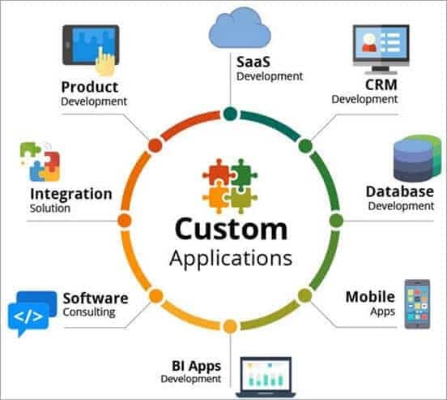
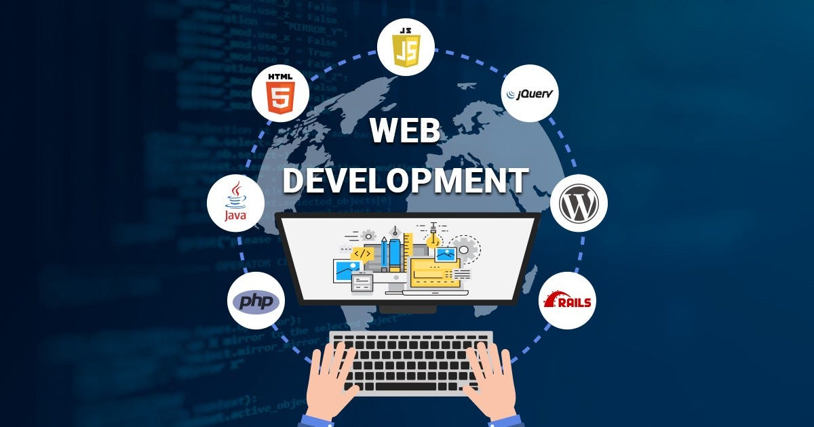

The company is established in 2017 and located in Balagavi, Karnataka, India.
Since 2017, the company have been providing consulting service,
website development,
Design and IoT application development.
And 100% responsive business websites.

Slide 5
Vision and mission of the organization
Vision: To build a reputation of being one of the most innovative IT Solution and Service provider.
Mission: To produce excellent services in the field of IT Services and Consultancy with maximum efforts driven towards customer satisfaction.

Slide 6
Organization structure
CEO
Highest Rank
Executive
Member
Marketing
Department
Manager
Selling
Department
Manager
Development
Department
Manager
Testing
Department
Manager
Service
Department
Manager
Team
Team Lead
Team
Team Lead
Team
Team Lead
Team
Team Lead
Team
Team Lead

Slide 7
Roles and Responsibilities of personnel
The roles and responsibilities of personnel within the organization vary depending on their job functions and departmental affiliations.
The personnel within the organization are expected to adhere to the company's values and principles while carrying out their duties.

Slide 8


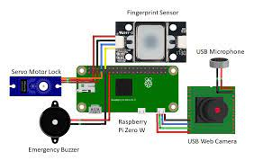
Products and market performance
List of the products of TechifyIndia
CashewSoft ERP(Enterprise Resource Planning)
TAX-E(GST Billing)
CNC Monitoring
IOT Based Smart Bell, etc.

Slide 9
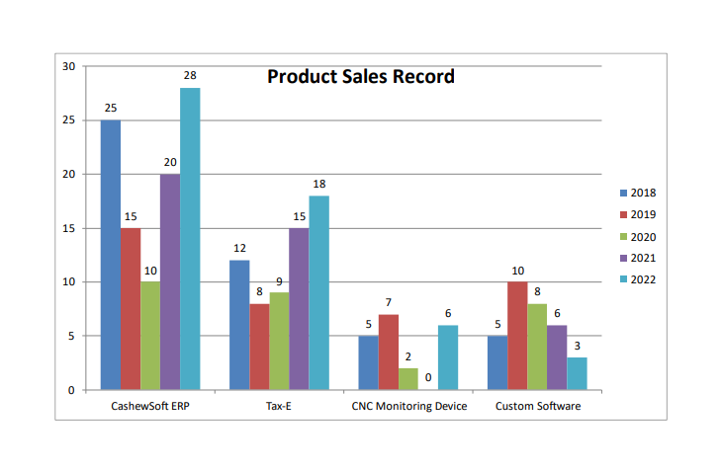

Slide 10
Year | Products Sell Records
 | Cashew Soft | Tax-e GST(Billing) | CNC Monitoring | Custom S/W
2018 | 25 | 12 | 5 | 5
2019 | 15 | 08 | 7 | 10
2020 | 10 | 09 | 2 | 8
2021 | 20 | 15 | 0 | 6
2022 | 28 | 18 | 6 | 3
Total | 98 | 62 | 20 | 32

Slide 11
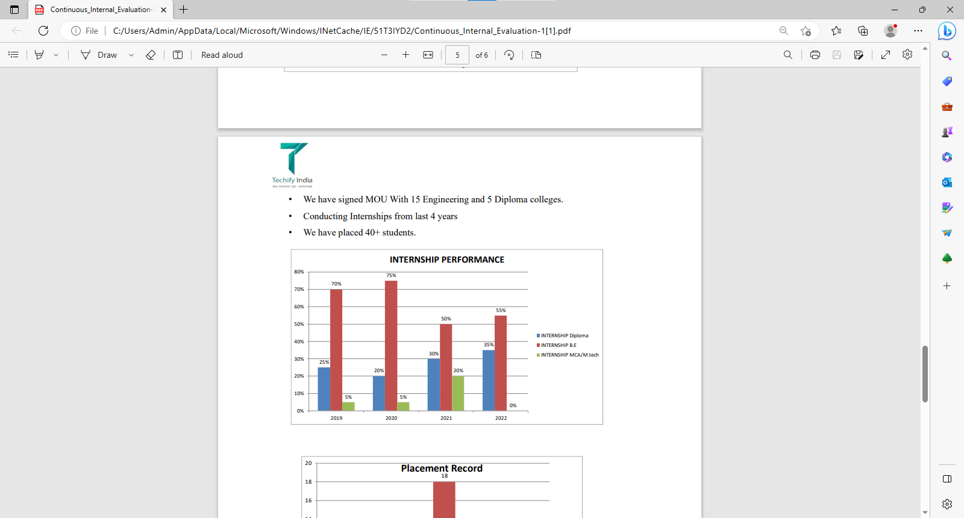
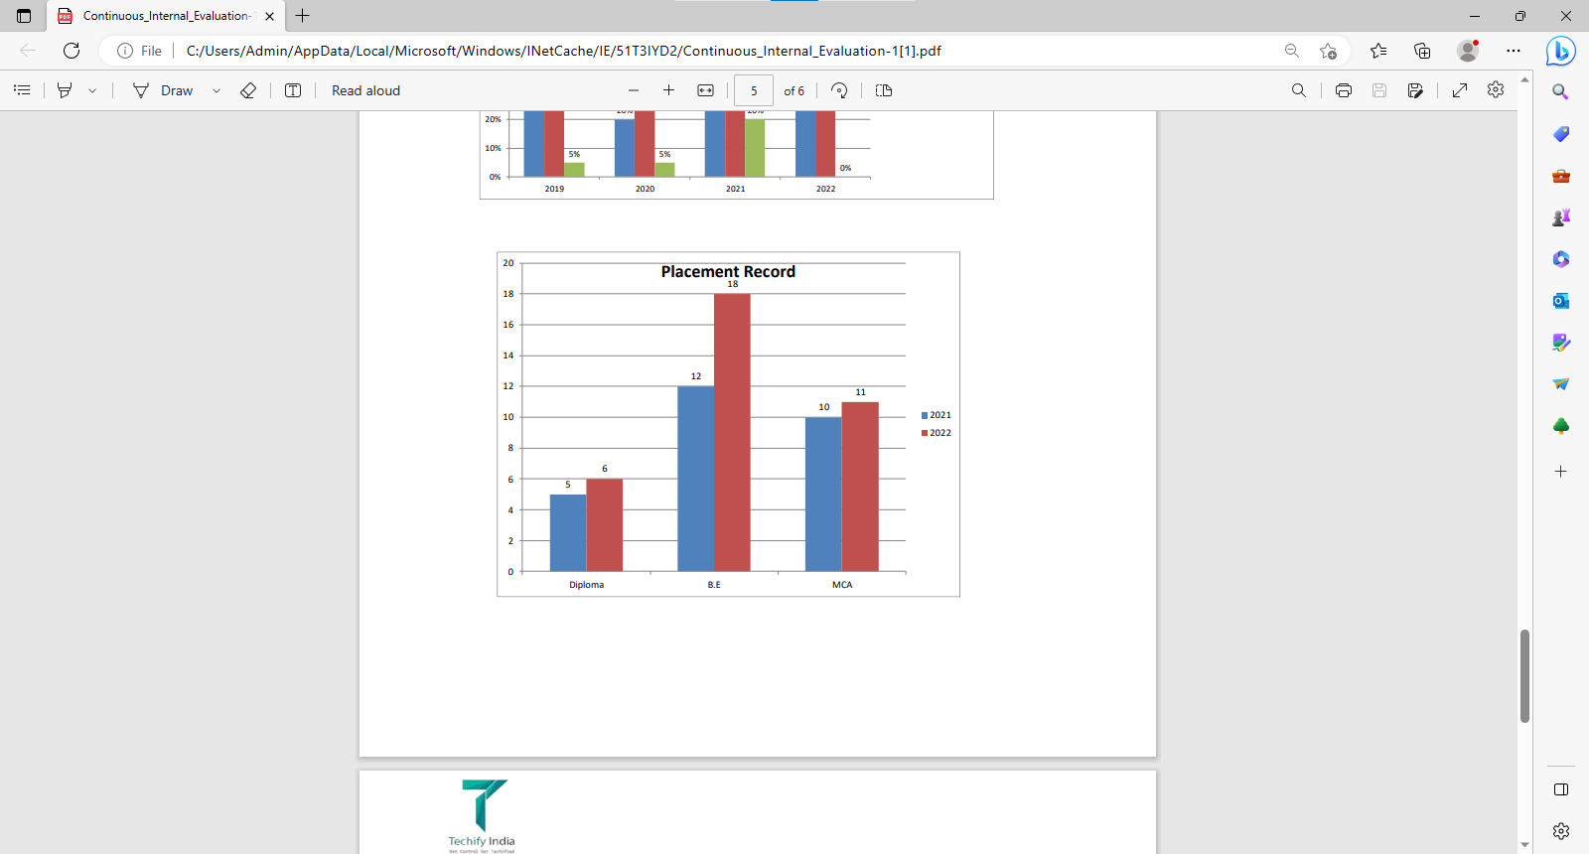
• We have signed MOU With 15 Engineering and 5 Diploma colleges. • Conducting Internships from last 4 years • We have placed 40+ students.

Slide 12
2. On job Training - I
PYTHON PROGRAMMING WITH OOP’s
Python is an high-level, interpreted programming language that emphasize code readability and simplicity.
Python is known for its elegant syntax and easy-to-understand code, making it a popular choice for beginners and experienced developers.
It supports various programming paradigms, including procedural, functional, and object – oriented programming (OOP)
Python programming with an emphasis on OOP principles, concepts, and implementation.

Slide 13
OBJECT ORIENTED PROGRAMMING (OOP)
Object oriented programming is a programming paradigm that provide a structure way to design and build software.
Classes and object : In oop, a class representation a real-world entity. It defines the structure and behavior that objects of that class will possess. Object is an instance of class representing a specific entity
Encapsulation : encapsulation is a function principle of oop that combines data function into a single unit called a class.
Inheritance : inheritance is a mechanism that allows a class to inherit attribute and method from another class, called the base class or parent class.
Polymorphism: polymorphism is the ability of object of different classes to be treated as object of a common base class

Slide 14
IMPLEMENTATION OF OOP IN PYTHON
Class Definition : class is defined using the class kyword followed by the class name and a colon.
Constructor method is named __init__() and is used to initialize the attribute of the object.
Destructor method __del__(), can be defined to perform cleanup operation before an object is destroyed and memory is released.
Inheritance Syntax: to create a derived class that inherits from a base class, you include the base class name in parentheses after the derived class name in the class definition.
Method Overriding: method overriding allows the derived class to provide its own implementation of method inherited from the base class

Slide 15
BENEFITS OF OOP IN PYTHON
Reusability.
Modularity.
Flexibility and Extensibility.
Encapsulation and Information hiding
Improved code organization: OOP promotes better code organization and design by providing clear structures for managing complexity

Slide 16
IMPORTANT FUNCTION OF PYTHON
Map: The map() function in Python is used to apply a given function to each item in an iterable
Filter: The filter() function in Python is used to filter out elements from an iterable based on a specified condition.
Reduce: The reduce() function is part of the functools module in Python. It is used to apply a specified function to the elements of an iterable in a cumulative way.
Lambda Functions: A lambda function is a small, anonymous function in Python. It is defined using the lambda keyword and can take any number of arguments but can only have one expression.

Slide 17
3. USECASE-I
MUSIC PLAYER APPLICATION
1) Audio Playback:
Support for various audio file formats, such as MP3, WAV, FLAC, AAC, etc.
Shuffle and repeat options to enhance the listening experience.
Volume control to adjust the audio output.
2) Library Management:
Organize the music library by albums, artists, genres, or playlists.
Search functionality to quickly find desired songs.
3) Playlist Management:
Create custom playlists by adding songs from the library.
Edit, reorder, and delete songs within playlists.
Smart playlists based on criteria like recently added, most played, etc

Slide 18
PROBLEM STATEMENT
You are tasked with building a simple music player application that can play different types of music files. Implement a Python class called MusicPlayer that represents a music player. The MusicPlayer class should have the following attributes and methods:
A. Attributes:
Playlist (list of strings): A list of music files in the playlist.
current_song (string): The name of the currently playing song.
B. Methods:
_init_(self, playlist): Initializes a new music player with the given playlist.
play(self, song): Plays the specified song from the playlist and updates the current_song attribute accordingly.

Slide 19
PROBLEM STATEMENT CONT’D…….
pause(self): Pauses the currently playing song.
resume(self): Resumes playing the currently paused song.
stop(self): Stops playing the current song and resets the current_song attribute to an empty string.
add_song(self, song): Adds the specified song to the playlist.
remove_song(self, song): Removes the specified song from the playlist.
Write the MusicPlayer class implementation and provide a sample code snippet that demonstrates the usage of the class by creating an instance of MusicPlayer and performing various operations on it.
Feel free to add any additional helper methods or attributes to enhance the functionality of the MusicPlayer class if you wish

Slide 20
AI IMPLEMENTATION
In the context of a music player, AI could be incorporated to enhance various aspects, such as:
In this program we create a playlist where the user can add the number of songs in the playlist. We can also run the song, change the song and also run another song
Which user can add the song in the playlist. Also add the different song in the playlist and user can remove the different in the playlists.
The running song user can stop and play another song in the playlists and user change the song by clicking next.
These are just a few examples of how AI can be utilized to enhance the functionality of a music player.

Slide 21
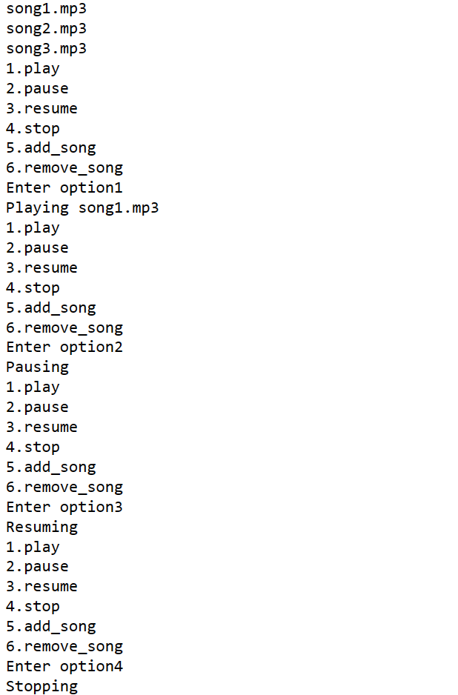
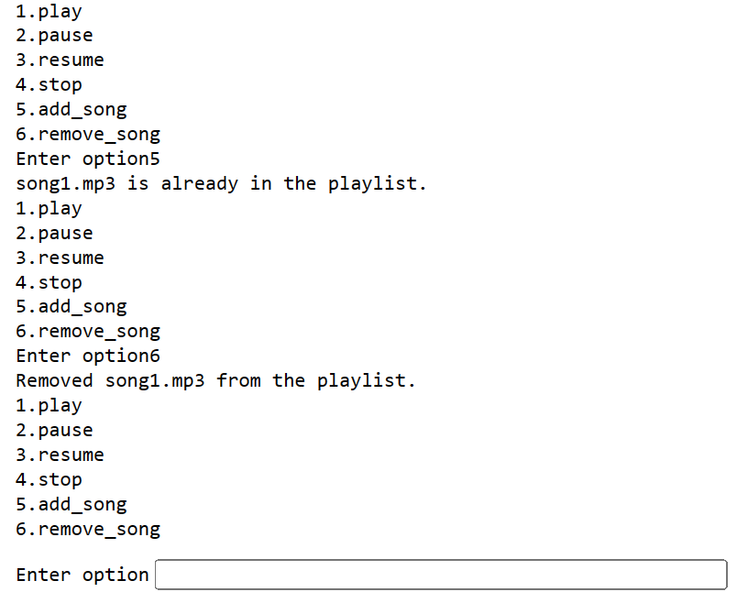

Slide 22
4. On Job Training - II
ARTIFICIAL INTELLIGENCE
AI application include advanced web search, recommendation systems, understanding human speech, self driving cars, generative or creative tools, automated decision making, and competing at the highest level in strategic game system.
The various sub field of AI research are centered around particular goals and the use of particular tools.
The traditional goals of AI research include reasoning, knowledge representation, planning learning, natural language processing, perception, and ability to move and manipulate objects.

Slide 23
TYPES OF AI
Artificial narrow intelligence: AI designed to complete very specific actions unable to independently learn.
Artificial general intelligence: AI designed to learn, think and perform at similar levels to humans.
Artificial superintelligence: AI able to surpass the knowledge and capabilities of human.
Reactive machines: AI capable of responding to externals stimuli in real time, unable to build memory or store information for future.
Theory of mind: AI that can sense and respond to human emotions, plus perform the tasks of limited memory machines.
Self-aware: AI that can recognize others emotions, plus has sense of self and human level intelligence, the final stage of AI

Slide 24
MACHINE LEARNING
Machine learning is a branch of artificial intelligence (AI) and computer science which focuses on the use of data and algorithms to imitate the way that humans learn, gradually improving its accuracy.
Machine learning is an important component of the growing field of data science.
These insights subsequently drive decision making within applications and businesses, ideally impacting key growth metrics.
Machine learning algorithms are typically created using frameworks that accelerate solution development, such as TensorFlow and PyTorch

Slide 25
MACHINE LEARNING METHODS
Supervised machine learning: Supervised learning, also known as supervised machine learning, is defined by its use of labeled datasets to train algorithms to classify data or predict outcomes accurately.
Unsupervised machine learning: Unsupervised learning, also known as unsupervised machine learning, uses machine learning algorithm to analyze and cluster unlabeled datasets.
Reinforcement machine learning Reinforcement machine learning is a machine learning model that is similar to supervised learning, but the algorithm isn’t trained using sample data.

Slide 26
OpenCV
OpenCV open source computer vision library is an open source computer vision and machine learning software library
OpenCV was built to provide a common infrastructure for computer vision application and to accelerate the use of machine perception in the commercial product.
OpenCV is an open-source software library for computer vision and machine learning.
The OpenCV full form is Open Source Computer Vision Library. It was created to provide a shared infrastructure for applications for computer vision and to speed up the use of machine perception in consumer products

Slide 27
HAAR CASCADE DATASET
Haar cascade is an algorithm that can detect objects in images, irrespective of their scale in image and location.
This algorithm is not so complex and can run in real-time. We can train a haarcascade detector to detect various objects like cars, bikes, buildings, fruits, etc
The main concept behind the Haarcascade algorithm is to train a classifier to identify specific patterns or features in an image that correspond to the object of interest.

Slide 28
5. Use Case - II
SMART CITY MISSION
National Smart Cities Mission is an urban renewal and retrofitting program by the Government of India with the mission to develop smart cities across the country, making them citizen friendly and sustainable
The Union Ministry of Urban Development is responsible for implementing the mission in collaboration with the state governments of the respective cities.
Smart Cities Mission envisions developing an area within the cities in the country as model areas based on an area development plan, which is expected to have a ruboff effect on other parts of the city, and nearby citoes and towns.
The Smart Cities Mission is an initiative by the Government of India to improve the lifestyle of citizens living in that particular city or town.
This mission was first launched on June 25, 2015, by Indian Prime Minister Narendra Modi. Furthermore, the Union Ministry of Urban Development is in charge of executing the mission throughout the cities. A Special Purpose Vehicle (SPV) has also been created in each state and is headed by the CEO

Slide 29
FEATURES OF SMART CITY MISSION OF INDIA
The mission promotes the use of mixed land according to its per-area usage plan. Therefore, this allows the state to have vast land for multi-purposes and make the bye-laws accordingly.
Providing housing choices to everyone is another major goal of the Smart City projects.
The mission is set to give the people relief from congestion. Smart City India will also ensure the security of the people, promote communication, and reduce smog at the same time.
Developing recreational spots like gardens, parks, open gyms, playgrounds, and more are other major goals of the mission.
Government-related services are gradually going digital to promote transparency and accountability in the system and the people.
More transportation choices are also being promoted throughout the country. These include public transport and transit-oriented development (TOD)

Slide 30
PROBLEM STATEMENT
Detecting the human eyes. Here the program is detecting the driver’s eye while he is driving as open or closed.
It gives an alert message to driver if his/her eyes are closed while driving which prevent accidental case which occur due to fatigue or distraction while driving.
Which would help in smart city mission as it prevents accident in a smart city through our technology.
For this we are creating an OpenCV program which detect the human eye is open or closed for which it gives an alert to driver by alarm, seat vibration or suggesting to break

Slide 31
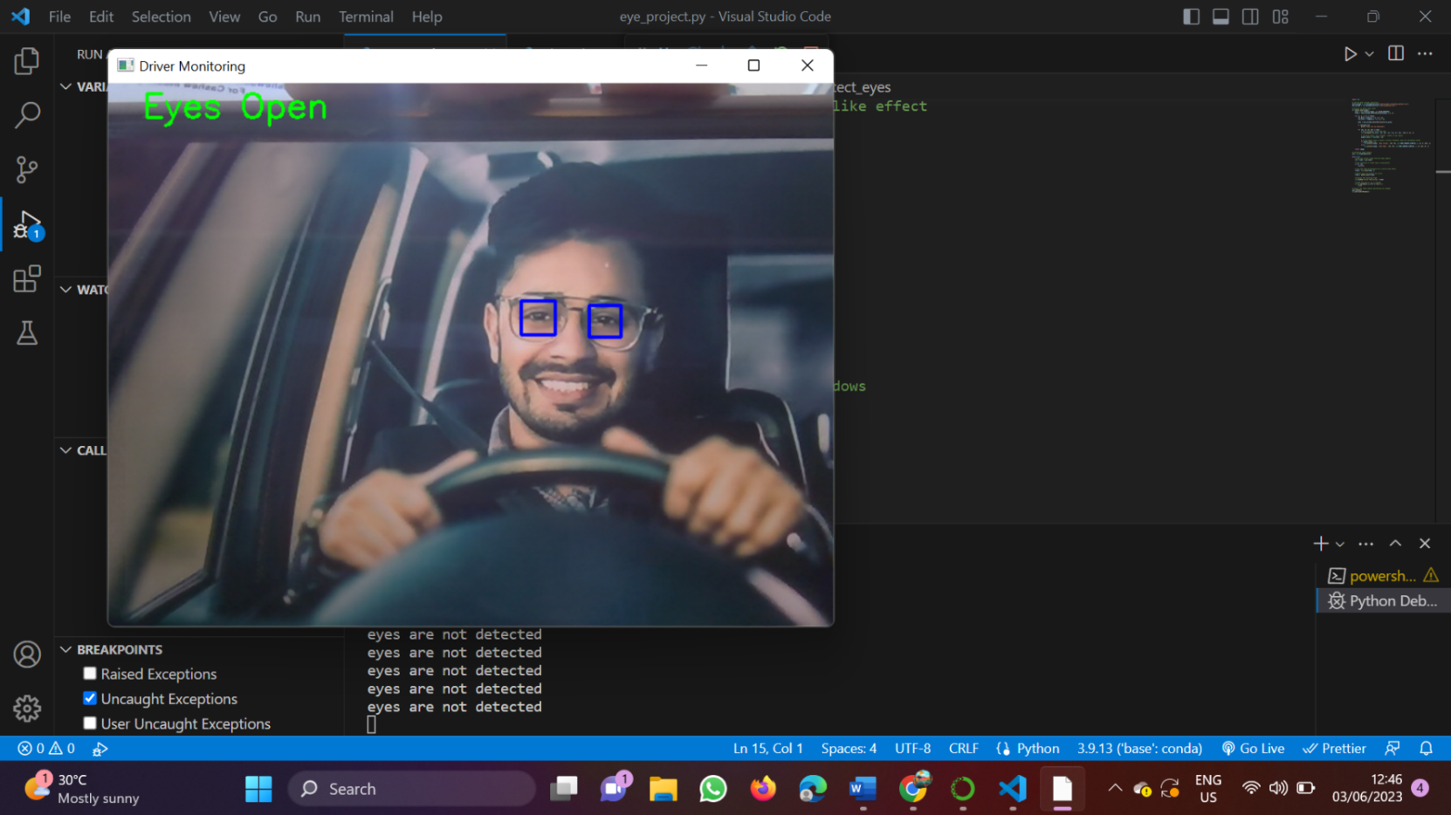
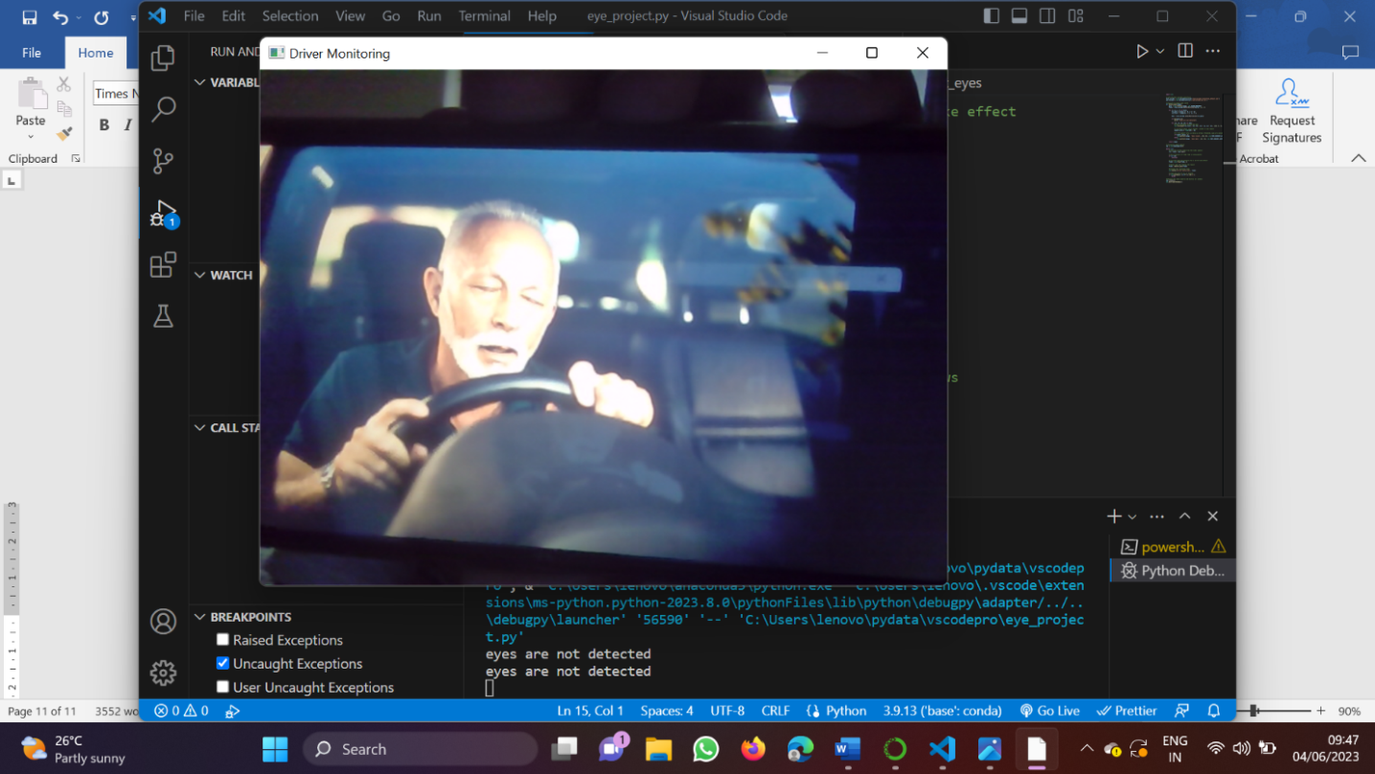

Slide 32
CONCLUSION
In company we trained about Python, OOP’s, Python implementation with OOP, Benefits of OOP in python, important function in python like lambda, map, reduce, filter in internship .
We were assigned with Music Player application using python programming language,where we are created some of methods like playing_song,pause_song,stopping_song,removing_song and adding_songs to the playlist.
During the internship we learnt about Artificial Intelligence, types of AI, Machine learning, OpenCv, Haar cascade dataset. We learnt about OpenCV through which the system can detect through its camera like human, human face, moving object, etc.
Assigned with task which implies drivers eyes detection using OpenCV. Here we created a program that detect the human eyes and gives a result that whether eyes are closed or open. Which would help in the smart city mission by implementing this number of accidents would become less which is occur due to drivers closed eye

